Slide 1

Fundamentals of Software Engineering
LECTURE 7:AGILE AND EXTREME PROGRAMMING
Farheen Tabassum MS Software Engineering EME,NUST

Slide 2



AGILE DEVELOPMENT
2

Slide 3
referred to as “Agile Alliance”, signed the “manifesto for Agile software development” It stated We are uncovering better ways of developing software by doing it and helping others do it
▶ 2001 Kent Beck and 16 other software developers,
▶ Through this work we have come to value
Agile Development
Individuals and interaction over processes and tool
Working software over comprehensive documentation
Customer collaboration over contract negotiation
Responding to change over following plan
▶ That is, while there is value in the items on the right we
value the items on the left more
3

Slide 4





Agile Principles
4
Agile Alliance defined 12 agility principles:
Highest priority is to satisfy the customer through early and continues delivery of valuable software.
Welcome changing requirements even late n the development (for customers competitive advantage).
Deliver working software frequently, from couple of weeks to couple of months.
Business people and developers must work together daily throughout the project.
Build project around motivated Individuals. Give them the environment and support they need, and trust them to get the job done.
Most efficient and effective method of conveying information to and with team is face to face conversation.

Slide 5
Agile Principles
5
Working software is the primary measure of progress.
Agile processes promote sustainable development. The sponsors, developers, and users should be able to maintain a constant pace.
Continuous attention to technical excellence and good design enhances agility.
Simplicity the art of maximizing the amount of work done is essential.
The best architectures, requirements, and designs emerge from self organizing teams.
At regular intervals, the team reflects on how to become more effective, then tunes and adjusts its behavior accordingly.

Slide 6







Agile Methods
6
Agile software development is a group of software development methodologies that are based on similar principles.
Agile methodologies generally promote a project management
process that encourages
frequent inspection and adaptation
a leadership philosophy that encourages team work
a set of engineering best practices that allow for rapid delivery of high quality software, and a business approach that aligns development with customer needs and company goals

Slide 7
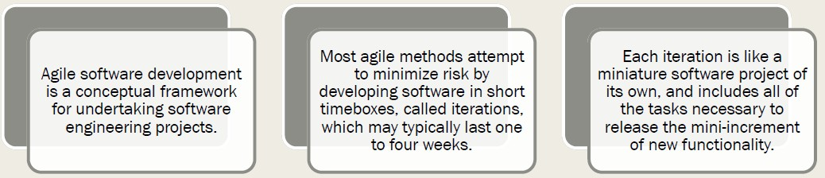
What are Agile Methods?

Slide 8
8
Agile methods emphasize Realtime communication, preferably face to face, over written documents.
Agile methods like XP relies on the close collaboration of actively engaged individuals with ordinary talents and has
Agile Methods v/s Traditional
Methods
the ability to flexibly schedule the
implementation of functionality,
responding to changing business needs.
Reference: Extreme Programming explained: Embrace Change By: Kent Beck with Cynthia Andres; 2nd ed., 2005

Slide 10

9
▶ Extreme Programming (XP)
▶ Scrum
▶ Adaptive Software Development (ASD)
▶ Crystal Clear and Other Crystal Methodologies
▶ Dynamic Systems Development Method (DSDM)
▶ Feature Driven Development
▶ Lean software development
▶ Agile Unified Process (AUP)
Agile variants

Slide 11

Extreme Programming
10

Slide 12
▶ XP (according to inventor Kent Beck) is characterized by 12 practices:
▶ Planning Game
▶ Small Releases
▶ Metaphor
▶ Simple Design
▶ Testing
▶ Continuous Integration
▶ Pair Programming
▶ Collective Ownership
▶ Refactoring
▶ 40 Hour Week
▶ On Site Customer
▶ Coding Standards
XP (Xtreme Programing)
11

Slide 13
What Xtreme Programming
is not
12
▶ that developers should have so much freedom that 30 years of established best practices are thrown out the window. I think this could be fairly termed XSP i.e. Xtremely Stupid Programming.

Slide 14

XP (Extreme Programming)
13
▶ XP Practices
▶ Planning game programmers estimate effort of implementing customer stories and customer decides about scope and timing of releases
▶ Short releases new release every 2 3 months
▶ Simple design emphasis on simplest design
▶ Testing development test driven.
▶ Refactoring restructuring and changes to simplify
▶ Pair Programming 2 people at 1 computer

Slide 15


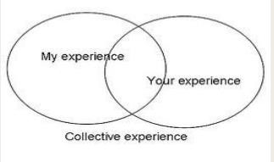

Pair Programming (Key practice of XP)
14

Slide 16
XP (Extreme Programming)
15
▶ XP Practices
▶ Collective ownership anyone can change any part of the code at any time.
▶ Continuous integration new builds as soon as code ready
▶ 40 hour week maximum 40 hour week. No overtime
▶ On site customer present and available full time for team
▶ Coding standards rules exist and are followed
▶ Open workspace large room small cubicles
▶ Just rules team has own rules but can be changed any at time

Slide 17
Key Practices of XP
16
▶ Planning
▶ User stories are written.
▶ Release planning creates the schedule.
▶ Make frequent small releases
▶ The Project Velocity is measured.
▶ The project is divided into iterations
▶ Iteration planning starts each iteration.
▶ Move people around
▶ A stand up meeting starts each day.
▶ Fix XP when it breaks.

Slide 18
Key Practices of XP…..
17
▶ Designing
▶ Simplicity
▶ Choose a system metaphor . (system of names for your objects that everyone can relate to)
▶ Use CRC cards for design sessions.
▶ Create spike solutions to reduce risk.
▶ Refactor whenever and wherever possible e.g. Techniques for improving names and location of code Move method or move field move to a more appropriate class or source file Rename method or rename field changing the name into a new one that better reveals its purpose

Slide 19
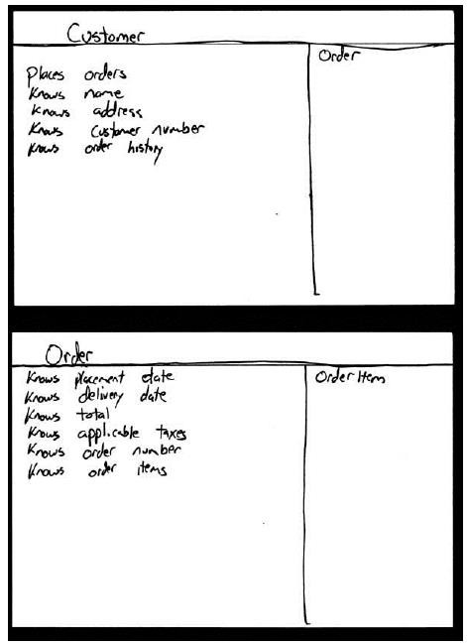
Class- responsibility- collaboration card
18

Slide 20
Key Practices …
19
▶ Coding
▶ The customer is always available
▶ Code must be written to agreed standards
▶ Code the unit test first
▶ All production code is pair programmed
▶ Only one pair integrates code at a time
▶ Integrate often
▶ No overtime .
▶ Testing
▶ All code must have unit tests
▶ All code must pass all unit tests before it can be released.
▶ When a bug is found tests are created.
▶ Acceptance tests are run often and the score is published.

Slide 21
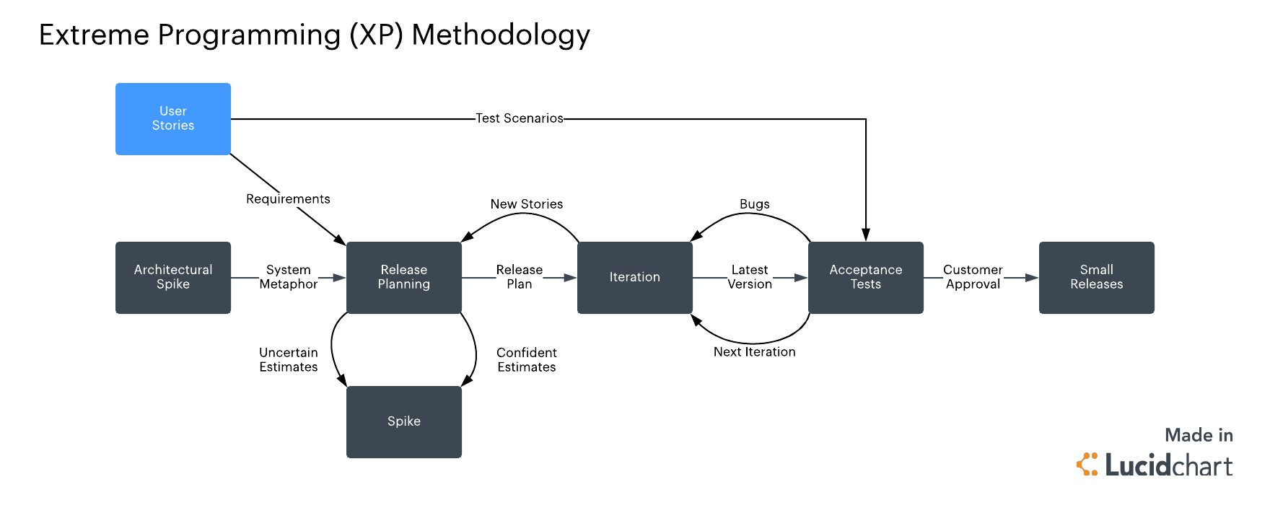
Fitting it all together
20

Slide 22
XP Advantages/Disadvantages
21
▶ Advantages
▶ Built In Quality
▶ Overall Simplicity
▶ Programmer Power
▶ Customer Power
▶ Synergy Between Practices

Slide 23
XP Advantages/Disadvantages
22
▶ Disadvantages
▶ Informal, little, or no documentation
▶ Scalability
▶ Contract Issues
▶ Misconception on the cost of change
▶ Tailoring

Slide 24
When to use / Not to use
23
▶ Applicable
▶ Highly uncertain environments
▶ Internal projects
▶ Joint ventures
▶ Not Suitable / Applicable
▶ Large, complex environments
▶ Safety critical situations
▶ Well understood requirements
▶ Distant or unavailable customer

Slide 25
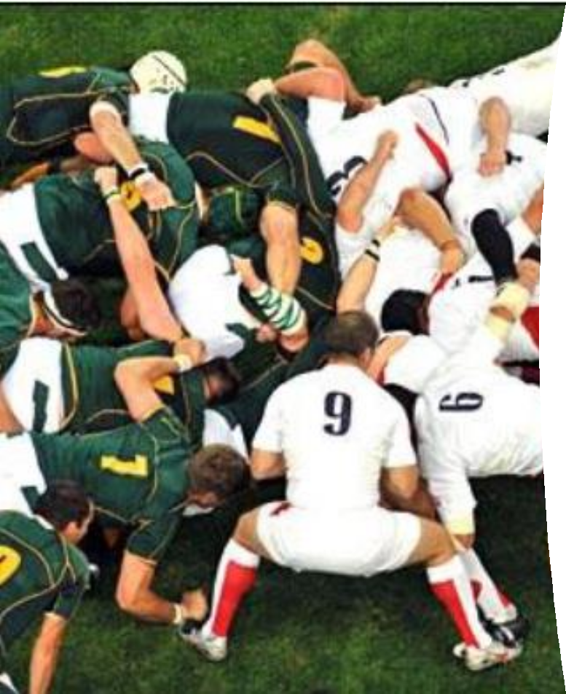
SCRUM
25

Slide 26
SCRUM
26
▶ First presented to OMG in 1995 by shared concerns between Advanced Development Methods (ADM) and
▶ VMARK Software (VMARK).
▶ ADM produces process automation software
▶ VMARK produces object-oriented software development environments
▶ Both companies were concerned over the lack of breakthrough productivity being reported in object-oriented development projects
▶ Not an acronym, Rugby team uses SCRUM meetings
▶ A scrum is a team pack in Rugby , everybody in the pack acts together with everyone else to move the ball down the field

Slide 27
27
▶ Scrum is an agile, lightweight process to
manage and control development work.
▶ Scrum is a wrapper for existing engineering practices .
▶ Scrum is a team based approach to iteratively, incrementally develop systems and products when requirements are rapidly changing
▶ Scrum is a process that controls the chaos of conflicting interests and needs
What is SCRUM ?

Slide 28
▶ Scrum is a communications operation .
28
way to improve
and maximize co
▶ Scrum is a way to detect and cause the removal of anything that gets in the way of developing and delivering products.
▶ Scrum is a way to maximize productivity .
▶ Scrum is scalable from single projects
to entire organizations
What is SCRUM ?

Slide 29
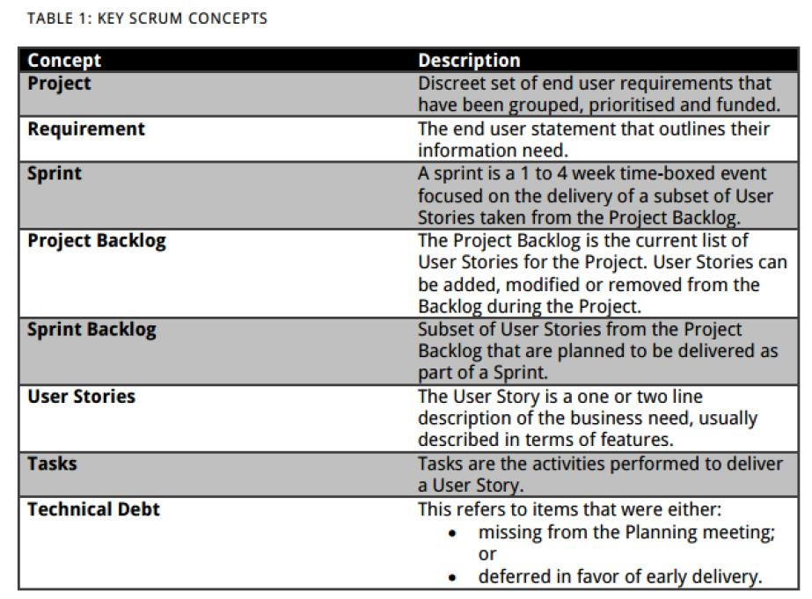

29

Slide 30

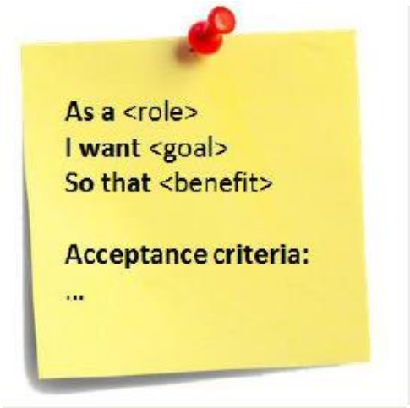
User Story Examples
30
▶ Standard template of a user story :
▶ As a < type of user>
▶ I want < some goal>
▶ so that < some reason>
▶ Ex1: As a power user, I can specify files or folders to backup based on file size, date created and date modified.
▶ Ex2: As a user, I can indicate folders not to backup so that my backup drive isn't filled up with things I don't need saved.

Slide 31
31
▶ Detail can be added to user stories in two ways:
▶ By splitting a user story into multiple, smaller user stories.
▶ By adding “conditions of satisfaction.”
▶ Ex1: As a vice president of marketing, I want to select a holiday season to be used when reviewing the performance of past advertising campaigns so that I can identify profitable ones.
▶ Detail could be added as:
▶ Make sure it works with major retail holidays: Christmas, Easter, President’s Day, Mother’s Day, Father’s Day.
▶ Holiday seasons can be set from one holiday to the next (such as Thanksgiving to Christmas).
▶ Holiday seasons can be set to be a number
of days prior to the holiday.
How is detail added to user
stories?

Slide 32
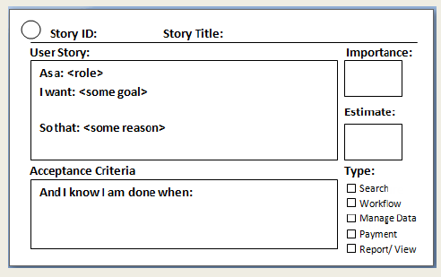
32

Slide 33

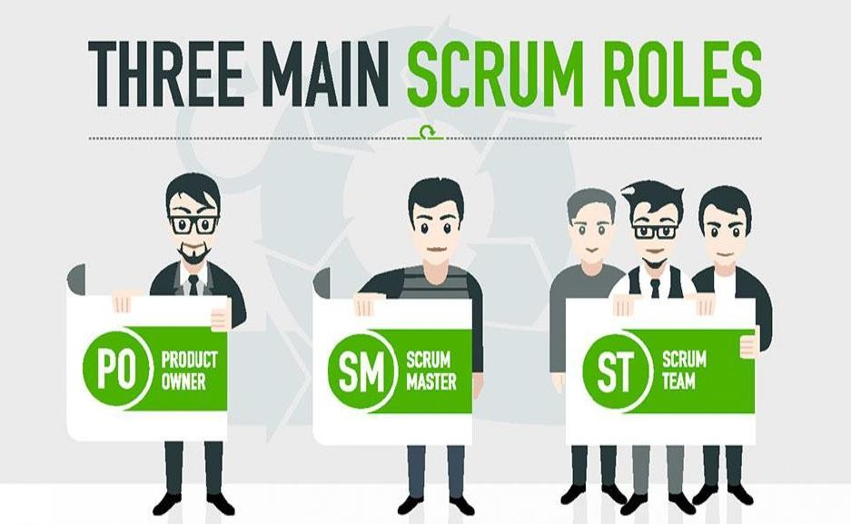
33

Slide 34


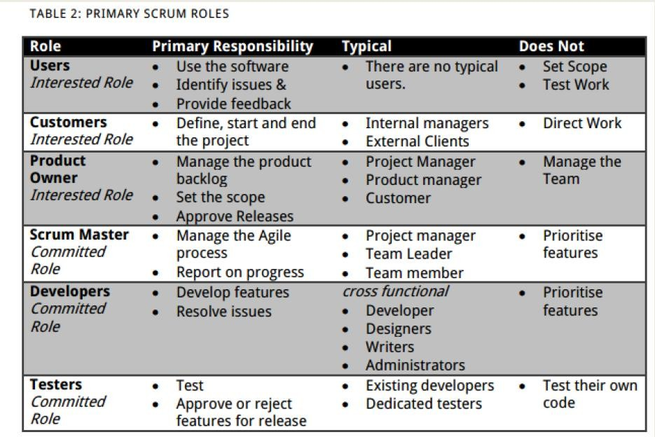
34

Slide 35
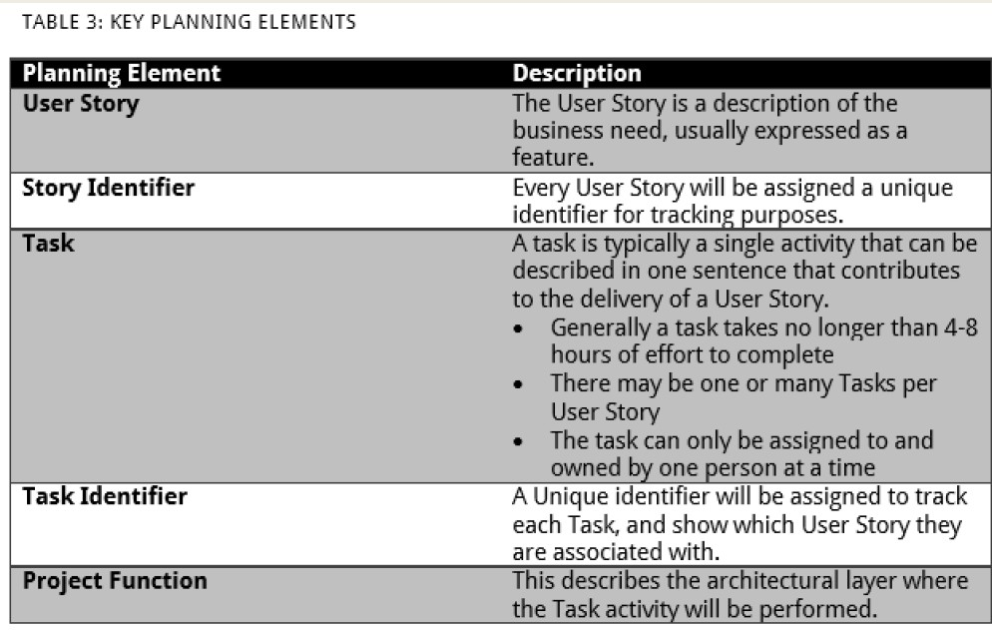
35

Slide 36
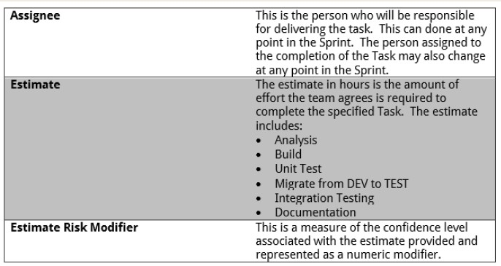
36

Slide 37
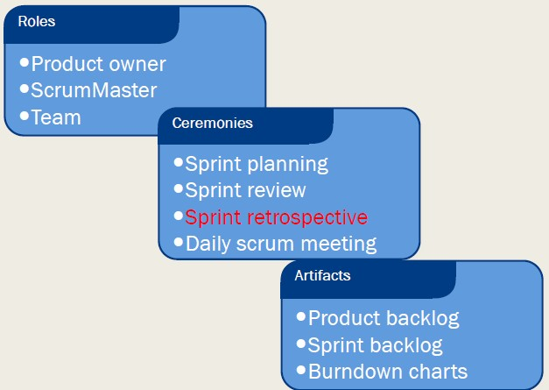
37
Scrum framework

Slide 38
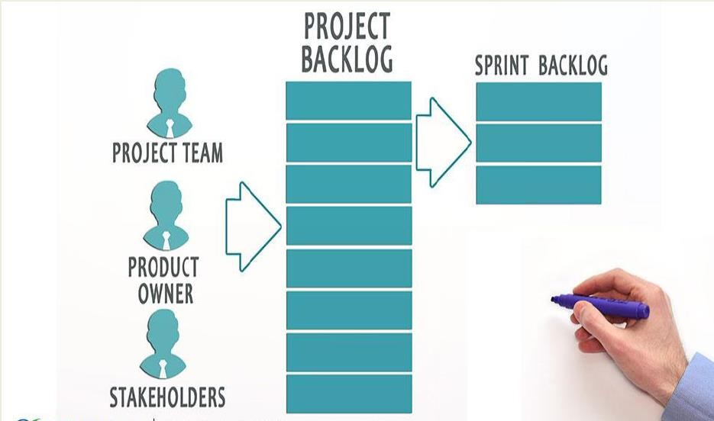
38

Slide 39

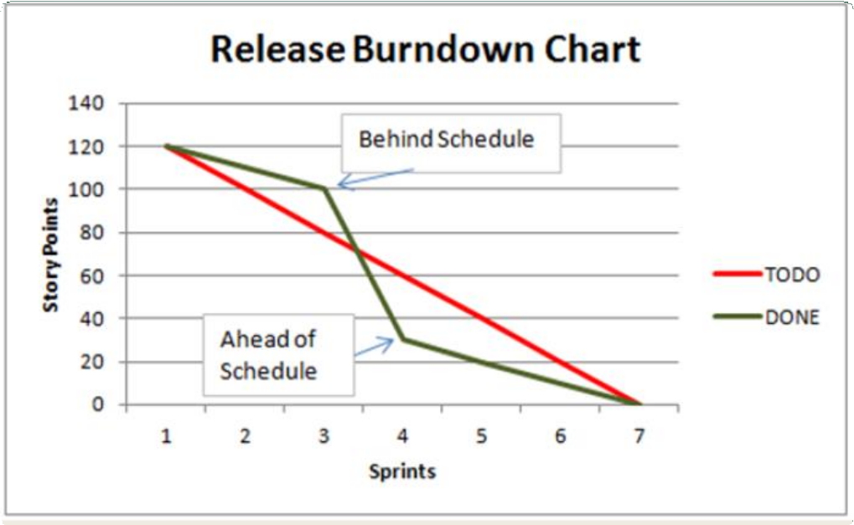
Example of Scrum Artefacts
39

Slide 40
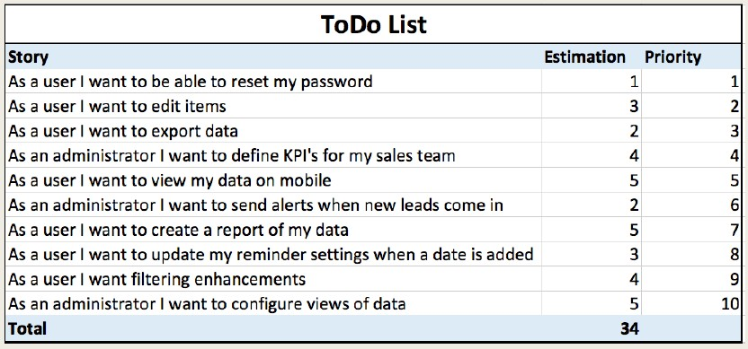
sample product backlog
40
A

Slide 41

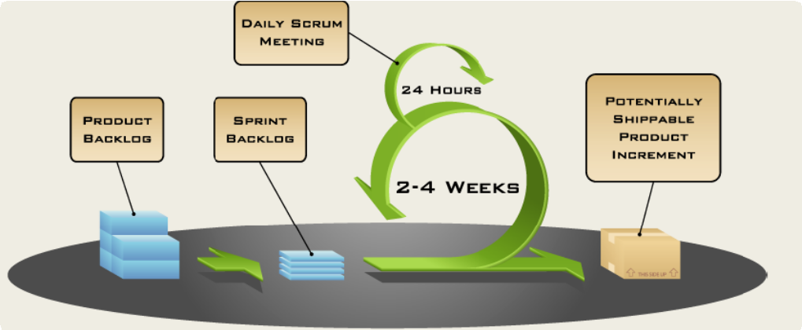
Putting it all together
41

Slide 42
42
▶ Define the features of the product
▶ Decide on release date and content
▶ Be responsible for the profitability of the
product (ROI)
▶ Prioritize features according to market value
▶ Adjust features and priority every iteration, as needed
▶ Accept or reject work results
Product Owner

Slide 43
43
▶ Represents management to the project
▶ Responsible for enacting Scrum values and practices
▶ Removes impediments
▶ Ensure that the team is fully functional and productive
▶ Enable close cooperation across all roles and functions
▶ Shield the team from external
interferences
The ScrumMaster

Slide 44
44
▶ Typically 5 9 people
▶ Cross functional:
▶ Programmers, testers, user experience designers, etc.
▶ M embers should be full time
▶ May be exceptions (e.g., database
administrator)
The team

Slide 45
The team
45
▶ Teams are self organizing
▶ Ideally, no titles but rarely a possibility
▶ Membership should change only between sprints

